Slide 1
Further development of the mpshift module:
improved efficiency and enhanced functionality
Thesis Advisory Committee June 22, 2017
Kevin Reiter

Slide 2

Further development of the mpshift module
PB1a: Vibrational Circular Dichroism (VCD) spectra
PB1: heavy elements (Z>36): relativistic core potentials
PB2: environmental / solvent effects: COSMO-Model + point charge model, + Gaussian smeared charge model
PB3: efficiency: RI-J approximation + multipole-accelerated RI-J (MARI-J) approximation

Slide 3
Vibrational circular dichroism: General theory and implementation (PB1a)

Slide 4
VCD: General theory and implementation
Determination of the absolute configuration of chiral molecules through measurement and calculation of VCD-intensities: transition dipole moments: ground state → vibrational state n
Extension of the module (aoforce) for the calculation of the vibrational states:

Slide 5
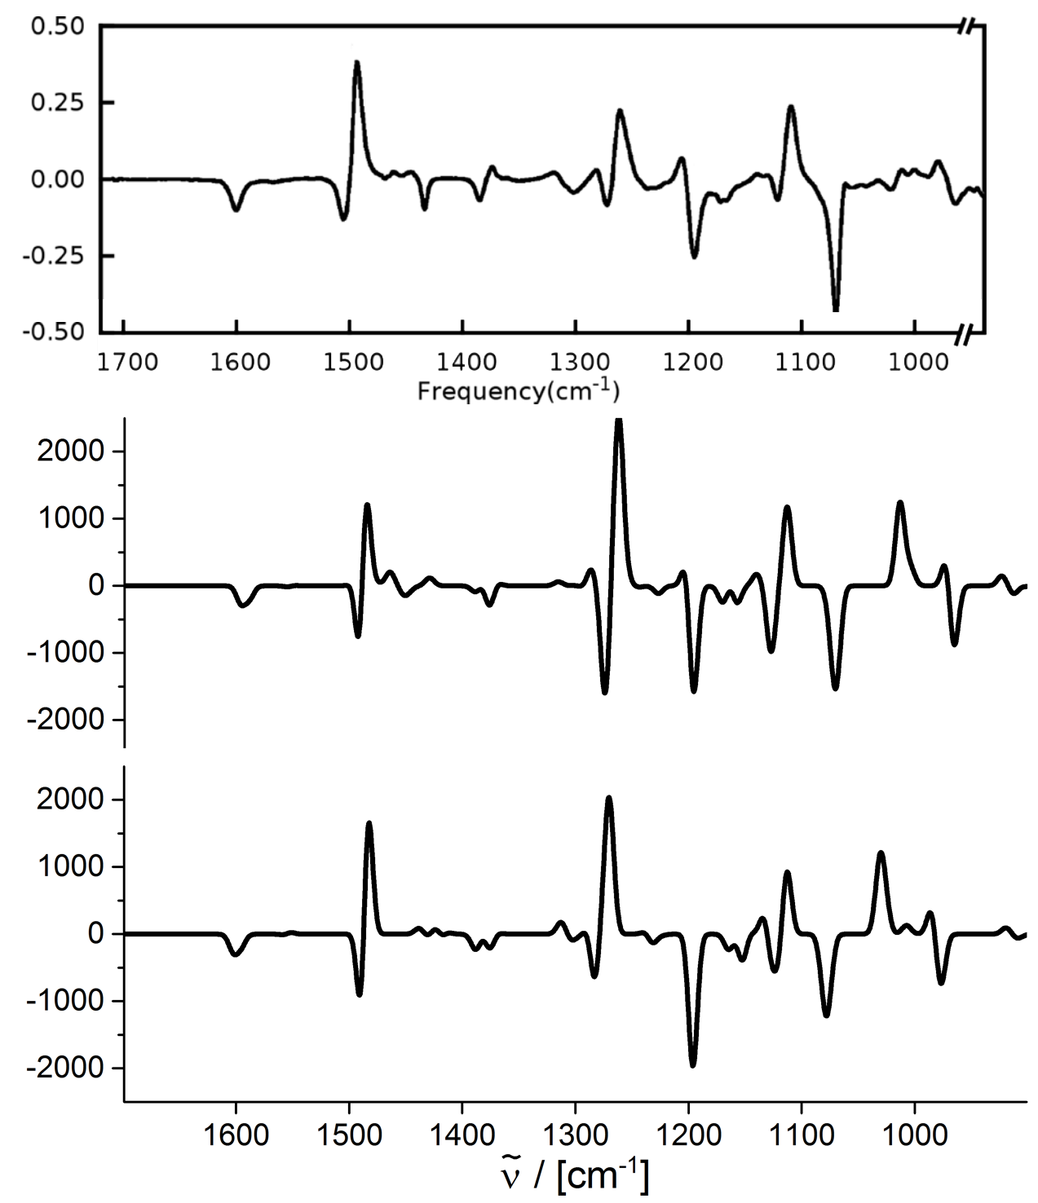
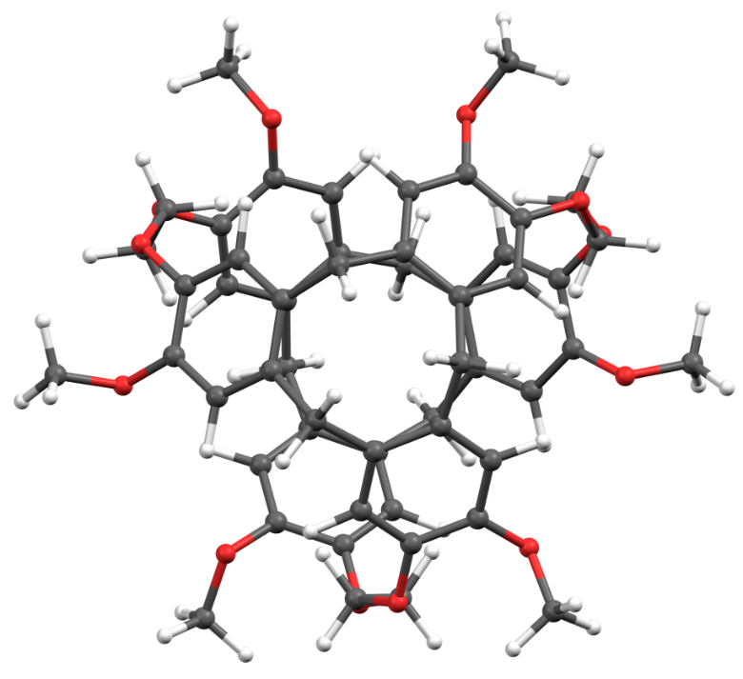
Application: (+)-cryptophane-A (D₃ symmetry)
Δε
experiment
B3LYP/def2-TZVP
R / [10⁻⁴⁴ esu²cm²]
4 CPUs: mpshift: 2.5 h aoforce: 89.5 h
B3LYP/def2-SV(P)
4 CPUs: mpshift: 0.1 h aoforce: 5.5 h

Slide 6
VCD and chemical shieldings with effective core potentials (PB1)

Slide 7
Effective core potentials
Heavy elements: relativistic effects also affect the valence shell and hence the chemical shieldings at the neighboring atoms
Those effects can be treated by the use of Effective Core Potentials (ECPs) V^{ECP}
Also for them gauge invariance has to be ensured Gauge Including Atomic Orbitals (GIAOs):
ECP-GIAO-formalism by van Wüllen finally results in:

Slide 8
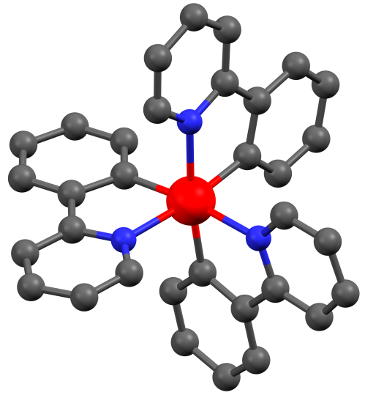
Shieldings with ECPs
Has been implemented in TURBOMOLE`s module mpshift and tested e.g. at M(ppy)₃, M = Ir, Co ppy = 2-Phenylpyridine
M=Co
)
σ
)
60
(
60
σ
tr
(
)
tr
)
40
40
ECP
ECP displ.
(
3
20
(
20
(ppy)
3
Co
0
(ppy)
0
Co
-20
-20
-20
0
20
40
60
-20
0
20
40
60
Co
(ppy)
all-electron
σ
(
)
tr
(
)
Co
(ppy)
ECP
σ
(
)
tr
3a
3
(
)

Slide 9
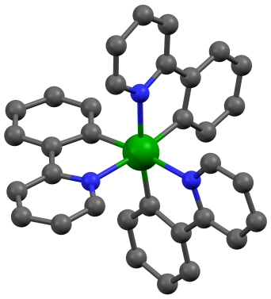
VCD with effective core potentials
BP86/def2-SV(P)
B3LYP/def2-SV(P)
1 CPU: mpshift: 0.1 h aoforce: 2.1 h
1 CPU: mpshift: 0.3 h aoforce: 10.1 h
BP86/def2-TZVP
B3LYP/def2-TZVP
1 CPU: mpshift: 0.9 h aoforce: 16.6 h
1 CPU: mpshift: 4.9 h aoforce: 167.5 h
M=Ir

Slide 10
Environmental / solvent effects (PB2)

Slide 11
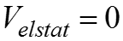
Environmental / solvent effects (PB2)
COnductor-like Screening Model (COSMO): - continuum solvation model - solute forms cavity within the dielectric continuum of permittivity ε - solute polarizes the dielectric medium → response is described by generation of screening charges Simulation of environmental / solvent effects by specification of on a shell around the molecule

Slide 12
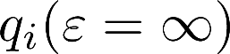
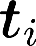
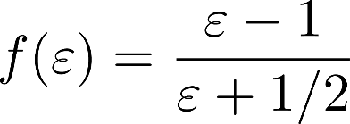
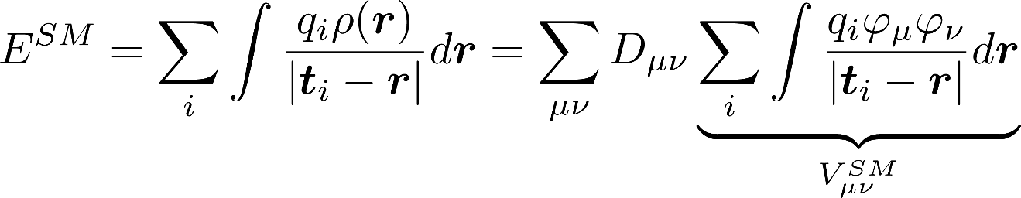
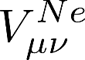
Environmental / solvent effects (PB2)
screening charges: on segments at position finite permittivity of real solvents → scaling by factor , with
Interaction energy: → same form as

Slide 13
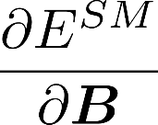
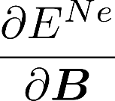
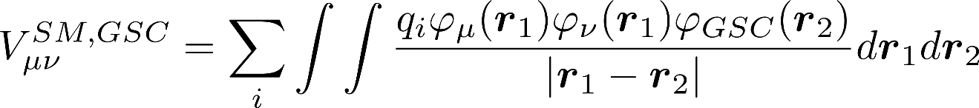
Environmental / solvent effects (PB2)
can be calculated with the same routines needed for
Same routine can be used for any point charges in gerneral → simple model to treat solvent effects with point charges
Alternative: Gaussian smeared charges → , see RI below

Slide 14
Environmental / solvent effects (PB2): application – acetone in water
Snapshots of acetone + water solvent molecules from MD-simulations (fixed structure parameters for acetone)
Different possibilities of solvent treatment
COSMO
model by point charges
model by Gaussian smeared charges
explicit calculation of water molecules
or combinations of b/c and d

Slide 15
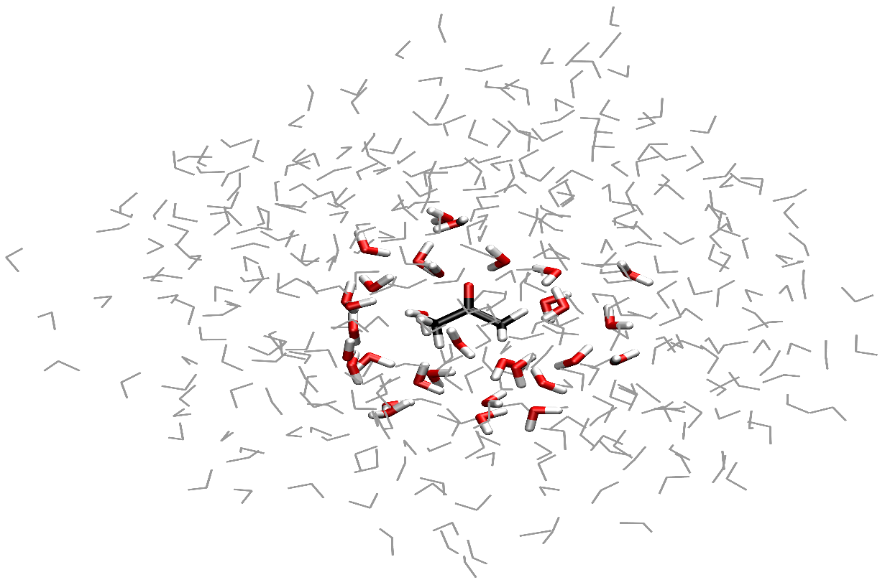
Environmental / solvent effects (PB2)
COSMO
Exp.
Exp.
Point charges
Gaussian
smeared charges
16 H
O + PC
2
16 H
O
2
32 H
O
2
64 H
O
2
40
60
80
100
120
140
-25
-20
-15
-10
-5
σ
σ
σ
σ
(
O
)-
(
O
)
/ ppm
(
C
=O)-
(
gas phase
C
=O)
gas phase
/ ppm
σ(O), σ(C) : average over 100 snapshots (414 H₂O)

Slide 16
Efficiency: RI-J approximation (PB3)

Slide 17
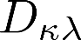
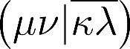
Efficiency (PB3): RI-J approximation
Derivative of two electron integrals w.r.t. the magnetic field
Coulomb part (formal O(N⁴) scaling behavior with the number of basis functions) is symmetric, is antisymmetric → second term vanishes

Slide 18
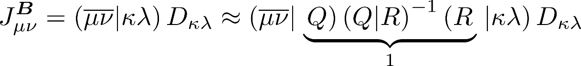
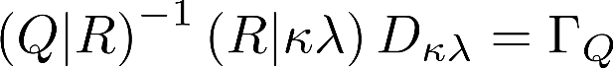
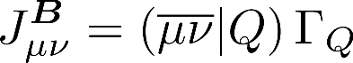
Efficiency (PB3): RI-J approximation
Resolution of the identity approximation: RI-J will be calculated in advance (like in ridft)
Final evaluation formal O(N³) scaling behavior with the number of basis functions

Slide 19
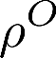
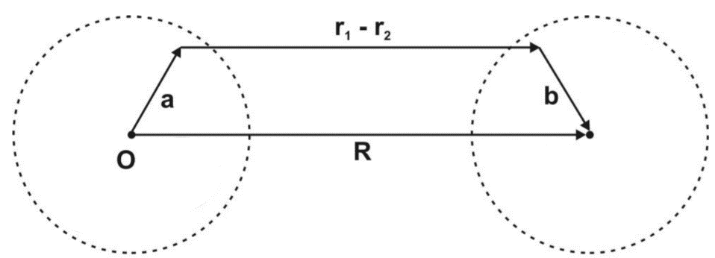
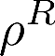
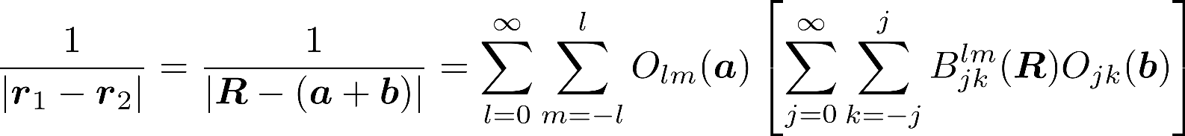
Efficiency (PB3): MARI-J approximation
Multipole accelerated resolution of the identity approximation: MARI-J Coulomb term is divided in a near-field (NF) and far-field (FF) part
NF part is evaluated by the RI-J approximation
FF part: Multipole approximation given by White and Head-Gordon:
M. Sierka, A. Hogekamp, R. Ahlrichs, J. Chem. Phys. 118, 9136 (2003).

Slide 20
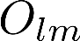
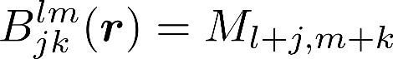
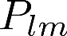
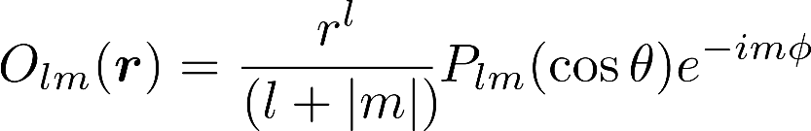
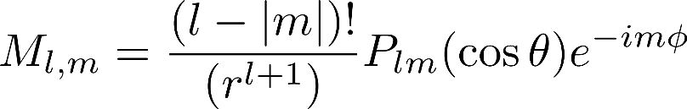
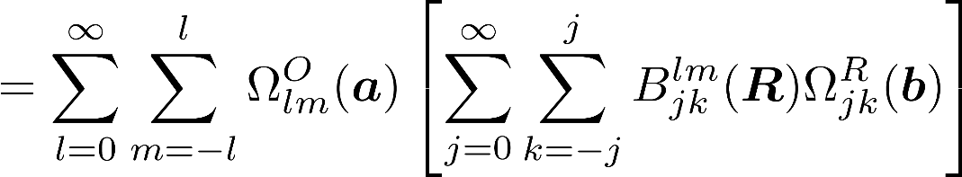
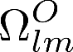
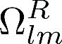
Efficiency (PB3): MARI-J approximation
and are defined in terms of Legendre polynomials
ρ^{Q} are atom centered charge distribution located at position Q
Coulomb interaction J_{OR} of two charge distributions ρ^{O} and ρ^{R} can be factorized
and are the multipole moments located at O and R
M. Sierka, A. Hogekamp, R. Ahlrichs, J. Chem. Phys. 118, 9136 (2003).

Slide 21
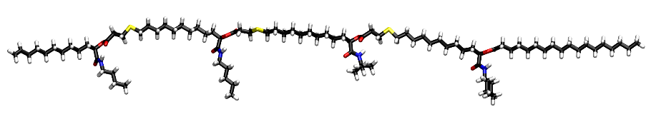
Efficiency (PB3): application I
Method: PBE/def2-TZVP
C₉₄H₁₇₄O₁₂N₄S₃ (287 atoms, 4565 basis functions)
CPU time
 | total | speedup | Coulomb part | speedup
Energy (MARI-J) | 42min
NMR | 5h43min |  | 5h16min
NMR (RI-J) | 51min | 6.7 | 22min | 14.3
NMR (MARI-J) | 33min | 10.4 | 5min | 66.3

Slide 22
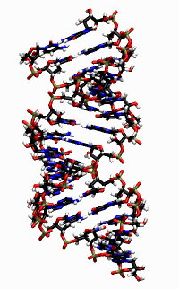
Efficiency (PB3): application II
COSMO application for a highly negatively charged DNA sequence
Method: PBE/def2-SV(P)/COSMO
[C₃₀₄H₃₄₆O₂₂₀N₁₁₈P₃₀]³⁰⁻ (1018 atoms, 10220 basis functions)
CPU time
 | total | speedup | Coulomb part | speedup
Energy (MARI-J) | 9h 52min
NMR | 43h 11min |  | 36h 9min
NMR (RI-J) | 10h 42 min | 4.0 | 3h 25min | 10.6
NMR (MARI-J) | 7h 38min | 5.7 | 20 min | 106.7

Slide 23
Efficiency (PB3): Accuracy of RI-J (MARI-J) and gauge invariance
difference between conventional mpshift and RI-mpshift for a small testset: CH₄, C₂H₆, C₂H₄, C₂H₂, CH₂O₂, C₂H₆CO, C₃H₈, C₄H₁₀, C₅H₁₂, C₆H₆, naphthaline, azulene, ferrocene, PMe₃, PPh₃, SiMe₄
mean absolute deviation maximum deviation H 0.00099 0.00689
C 0.05639 0.31802
def2-TZVP/BP86

Slide 24
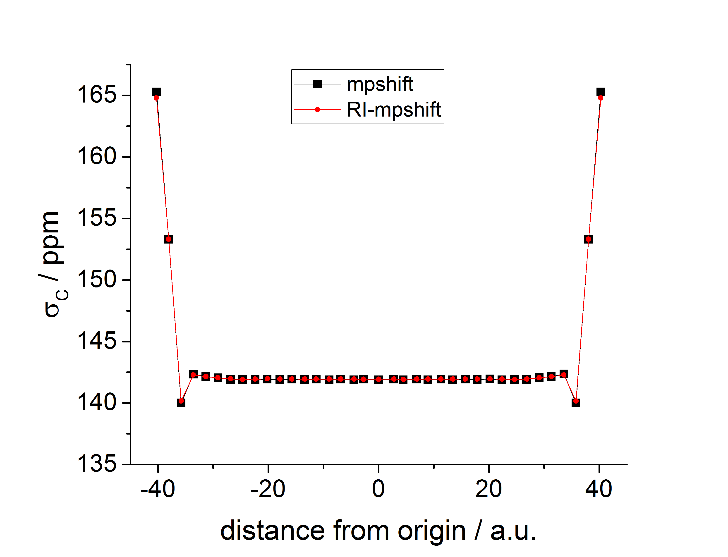
Efficiency (PB3): Accuracy of RI-J (MARI-J) and gauge invariance
Alkane chain with central C atom in the origin: comparison between conventional mpshift and RI-mpshift
def2-TZVP/BP86

Slide 25
Q5-B Further development of TURBOMOLE´s NMR module: outlook
PB3: efficiency: RI-J + MARI-J approximation (symmetry)
+ linear-scaling DFT routines (+meta-GGA-functionals) + parallelization
PB4: all electron relativistic (outlook at the 2nd period)
NMR-related cooperation

Slide 26
Acknowledgement
Florian Weigend
DFG for funding
Thank you for your attention!

